Slide 1
Welcome Kawartha Lakes Future Waste Options Study
Purpose of Today’s Open House:
To provide information about the Study and gather feedback which will help direct the City in the next steps.
How to engage
Jump in!
Review the information boards
Project team members are available to answer your questions and hear your comments
Visit the website to take the survey and learn more about the project

Slide 2
Objective and Purpose of the Future Waste Options Study
Study Objective
Review potential options for future waste disposal capacity once the City exhausts existing landfill capacity
Study Process
Review background information
Understand future residual waste quantities
Review alternative technologies
Review landfill related options
Develop evaluation criteria
Evaluate options
Identify preferred option and implementation considerations
Reporting
Consult on the process and preferred option
Project Purpose:
Decreasing landfill capacity as Lindsay Ops Landfill will reach capacity between 2030 & 2037
Provides focus for next steps
Helps determine implementation timelines

Slide 3
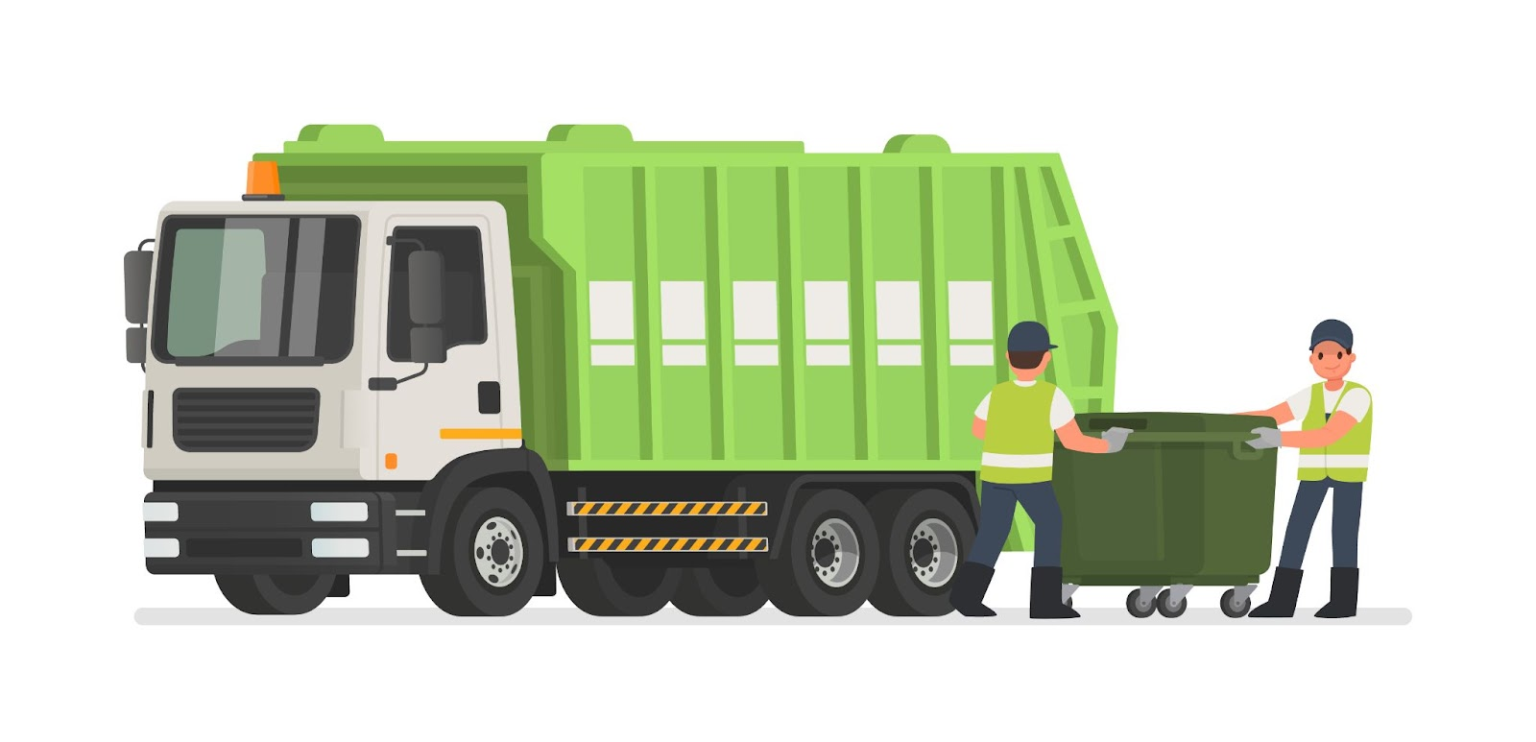
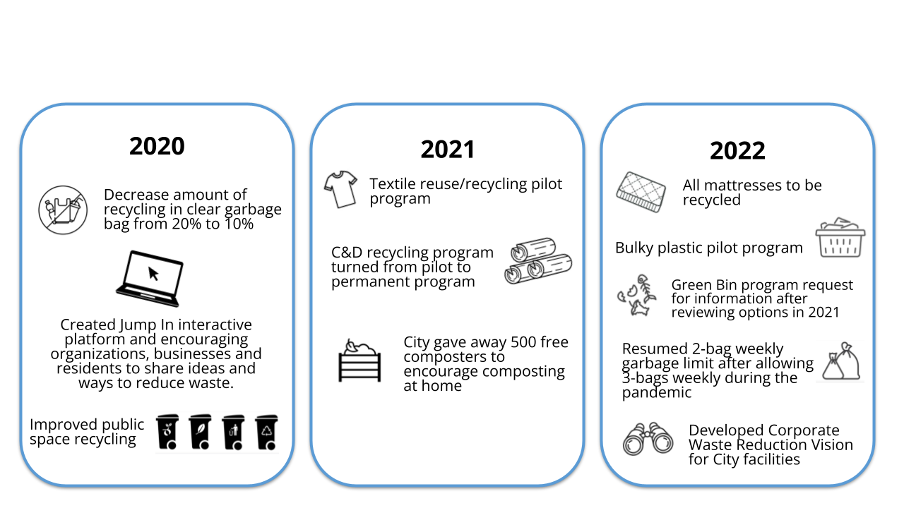
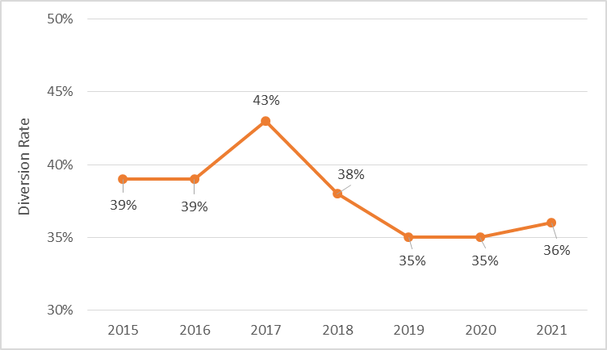
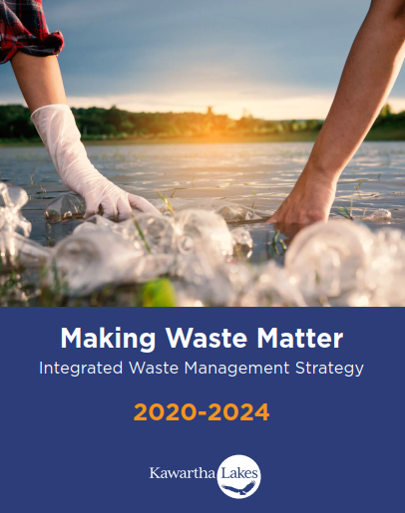
Current Waste Management System in Kawartha Lakes
Demographics
Services provided to ~75,000 residents
Services provided to ~31,000 seasonal residents
Curbside Collection Programs
Residential recycling & garbage
Commercial waste
Leaf & yard waste
Batteries
Large items, mattresses and appliances
Depots & Drop Offs
Electronics
Scrap metal
Mattresses
Construction & Demolition Waste
Textiles
Household Hazardous Waste
Batteries
Making Waste Matter
Increasing Diversion in Kawartha Lakes
Goal: Divert 70% by 2048
Note: The 2021 waste diversion rate is being verified.

Slide 4
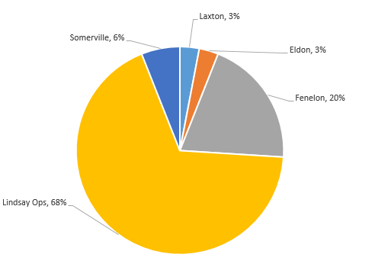
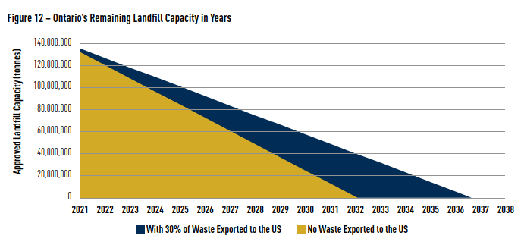
Current Waste Management System in Kawartha Lakes
Landfill Information
Breakdown of waste landfilled at each site (2021)
Landfill | Garbage Received in 2021 (tonnes) | Expected Closure Date*
Lindsay Ops | 32,500 | 2030 to 2037
Fenelon Falls | 10,000 | 2023 to 2024
Laxton | 1,200 | 2023 to 2024
Eldon | 1,600 | 2046
Somerville | 2,700 | 2084
*Closure date based on 2015 Making Waste Matters and ongoing separate City study and subject to change based on diversion rates and new programs, closure of other landfills and redirection to remaining sites, etc.
Landfills will reach maximum capacity by 2032 without exporting waste to the US
Landfills will reach maximum capacity by 2036 with continued export to the US
Jan 2021, OWMA Annual Landfill Report

Slide 5
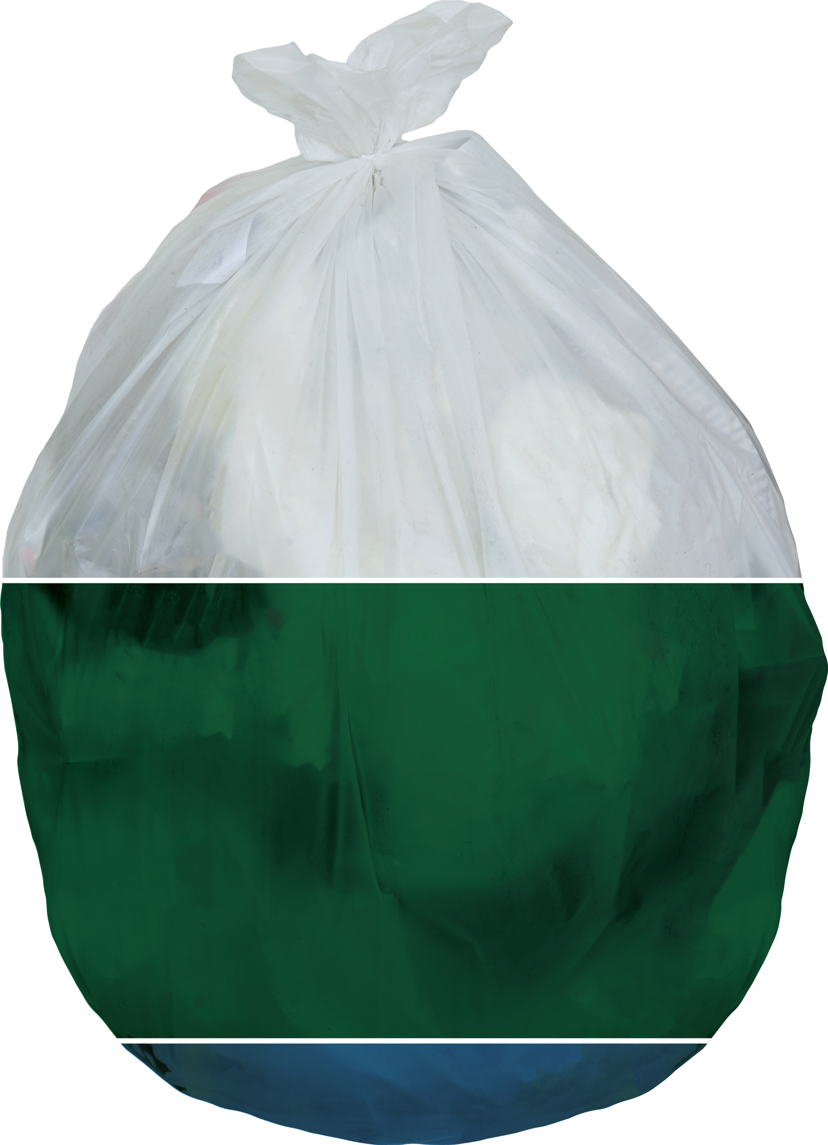
Future Residual Waste Quantities in Kawartha Lakes
Year | Status Quo | 35% Diversion Achieved | 53% Diversion Achieved | 70% Diversion Achieved
2021 | 47,000 | 47,000 | 47,000 | 47,000
2035 | 60,000 | 55,800 | 51,100 | 46,400
2048 | 91,500 | 75,300 | 55,000 | 34,700
40 %
Garbage
50 %
Organics
Making Waste Matter diversion target
10 %
Recycling

Slide 6
Options Evaluation
Evaluation Criteria and Indicators
Considerations
KEY Evaluation Assumptions
Economic Feasibility
Capital costs
Operational costs
Level of risk
Social Impacts
Public acceptance
Collaboration potential
Proven/unproven
Level of effort
Environmental Impacts
Climate change impacts
Energy
Nuisance impacts
Air quality impacts
Land requirements
Impacts to ground/surface water
Diversion potential
Process description
Operational experience
Target material
Outputs
Operations & capital costs
Advantages & disadvantages
Technology status (proven, unproven, pilot)
Applicability to the City
Able to manage 44,000 to 67,000 tonnes annually
Process and manage only residual waste generated within the municipality
Facility is located within Kawartha Lakes
Will require an Environmental Compliance Approval at minimum

Slide 7
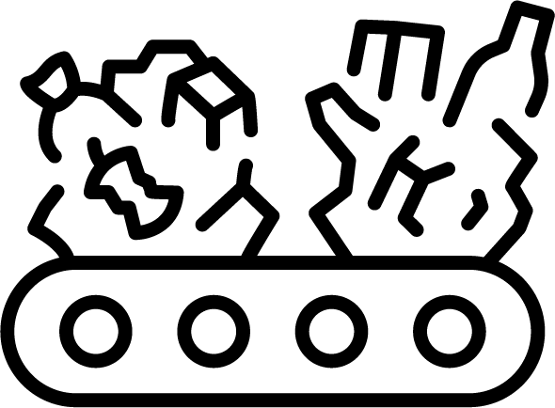
Alternative Technology Options
Mixed Waste Processing
Mass Burn Incineration
Gasification
Pyrolysis
A process which can recover recyclables, organics and/or reusable materials from garbage. Extracted materials are removed through manual sorting and/or the use of equipment.
Garbage is burned in a controlled facility and the heat that is created generates energy. Two types of ash are produced: bottom ash and fly ash.
Heats municipal solid waste in an oxygen-free environment and produces a combustible gaseous or liquid product and a carbon char residue.
Involves heating garbage in an oxygen-free environment to produce a gas or liquid product and a carbon char residue.
Effort, Capital & Operating Costs
Operating & Capital Costs, Risk, Unproven, Effort
Capital & Operating Costs, Risk, Effort
Capital Costs, Effort
Pros / Cons
Proven, Diversion
Proven, Climate Impacts, Energy, Diversion
Climate Change Impacts, Energy, Diversion
Climate Impacts, Energy, Diversion

Slide 8
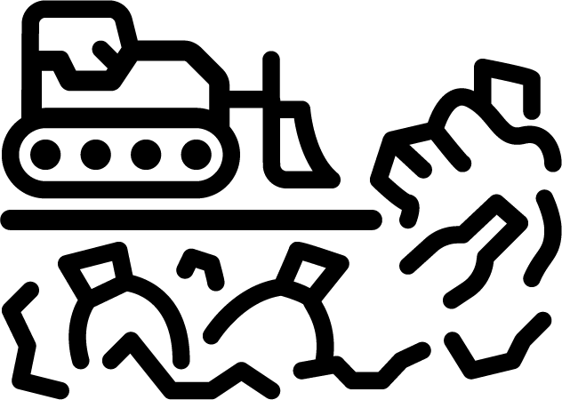
Landfill Related Options
Landfill Expansion
New Landfill
Landfill Mining
Exporting Waste
Privatization
Expand an existing City landfill site(s) vertically and/or horizontally.
City develops a new landfill site within Kawartha Lakes.
Previously landfilled waste is excavated to recover valuable materials, increase space, and/or improve environmental conditions at City site(s).
Garbage is hauled to disposal facility outside of Kawartha Lakes.
Options range from cooperative agreements with private firms to management contracts, asset sales or complete reliance on market for services.
Capital Costs, Risk, Effort
Climate Change Impacts, Diversion, Nuisances
Diversion, Climate Change Impacts
Diversion, Effort
Diversion, Risk
Pros / Cons
Risk, Operating & Capital Costs, Energy Produced
Ground/Surface Water Impacts, Land Required, Capital Costs
Effort, Collaboration, Capital Costs
Land Required, Air Quality, Operating & Capital Costs
Energy Produced, Operating Costs

Slide 9
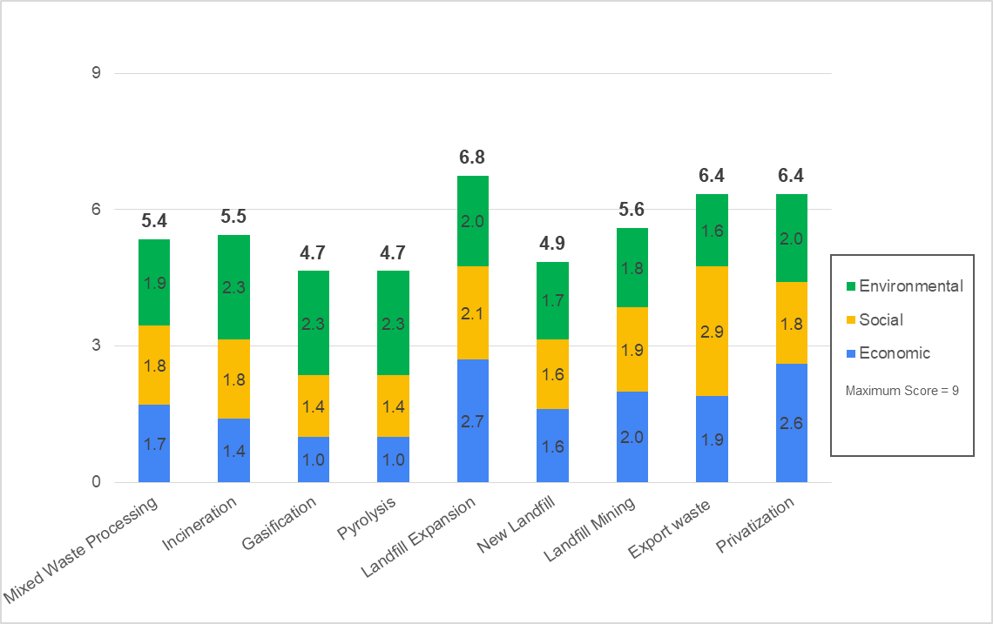
Preliminary Preferred Option Landfill Expansion
Economic Feasibility
Operating costs will be similar or less than
existing operating costs
Capital cost is in medium range compared to other options
Low risk given familiarity
Social Impact
Proven approach in Ontario and at the City
Requires lengthy EA process and consultation
Public concerns anticipated through consultation and current methods
Environmental Impact
More landfill gas will be generated potentially allowing for energy to be captured
Land requirements depend on the site(s) selected and expansion method
Current environmental management and monitoring practices will continue
Evaluation Results - Weighted Averages of Options
Financial
Environmental
Social
Technical/Operational
Regulatory
$2 - $5 million for an Environmental Assessment
$10 - 50 million for additional approvals, engineering, design & construction
Horizontal expansion may require clearing of trees/vegetation
Environmental investigations anticipated to determine suitability
Consultation program may mitigate public concerns
Minimal changes to noise/odour/traffic
Minimal changes to staffing needs
Construction cannot begin until regulatory approvals secured (~ 5 years)
Individual EA or amendment required
Horizontal expansion can take 3-5 years for approval

Slide 10
Next Steps For Decision Making
Next steps for the Future Waste Disposal Study:
2022: Study findings presented to Council
2022 - 2023: Council meeting to confirm next steps
If Landfill Expansion is pursued:
2023: Begin Terms of Reference for the EA
2027 - 2029 (4 - 6 years): Complete EA
2030 - 2034 (3 - 5 years): Design, engineering and construction
2036 - 2037: Commission and operation of approved option
Jump In!
Visit the website to take the survey and learn more about the project
Questions?
Project team members are available to answer your questions and hear your comments
Lindsay Ops Landfill forecasted to close between 2030 and 2037

